Slide 1

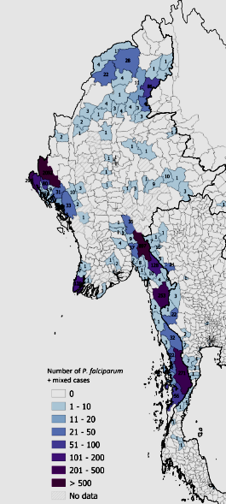
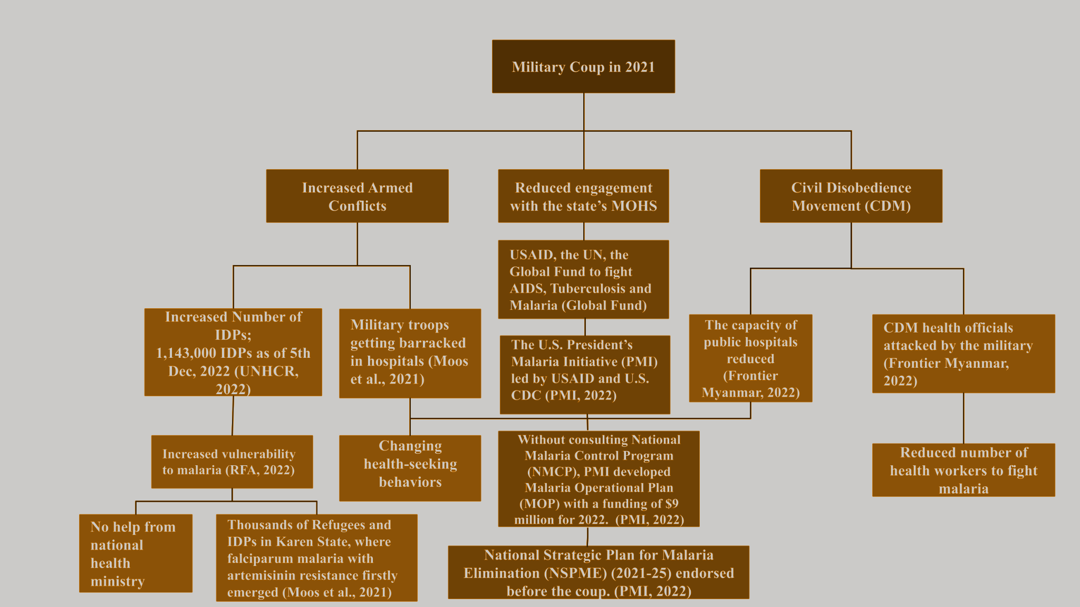
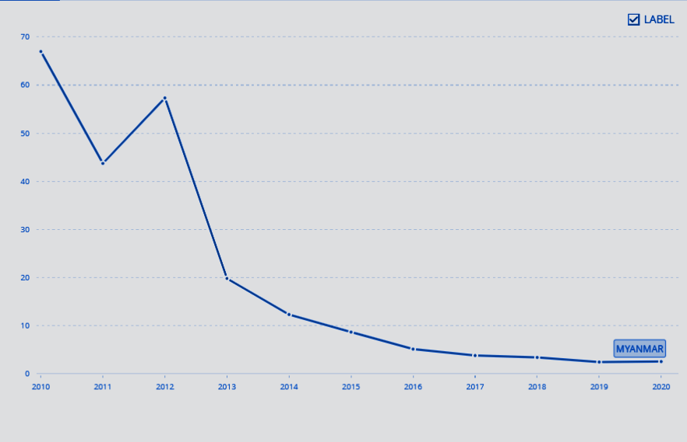
Malaria Update : Myanmar Current Situation
Ei Mon Soe, Htut Htet Naing, Hla Mong Ching, Khaing Thazin Phyoe, Myat Moe Kywel, Pann Ei Thwel, Soe Yadanar Htet, Thantlip Laomi, Thant Thaw Tun, The The Zuu Zin, Thu Ri Ya Tun, Zin Wai Yan
Seeking help from home
Because of Covid-19 and the military coup in 2022, more people are displaced to forest where it has a high risk for infection
Patients with malaria in rural area have to seek treatment with vigilance relying on limited layman medical knowledge.
For example, suspected malaria patients lookout for home remedies such as herbs, and seeds, and DIY traditional medicine such as turmeric with milk and pepper with ginger instead of seeking professional help.
Despite the knowledge that home remedies will not cure malaria, people hold onto the hope to get better because of the limited and unaffordable medical supplies.
Conclusion
Data suggest that recent elimination efforts done by the national government in collaboration with international support such as WHO, global fund, private, and public entities during 2016-2020 prompted a significant decrease in malaria burden.
Recent political and social development leads to the destruction in prevention and control measures, that hinders to go further to eliminate malaria in Myanmar.
Poor health knowledge which has not fully been addressed, contributes to the higher misleading treatments when facing social, political, economic difficulties recently.
Current situation update of Myanmar indicates that there is high potential for risks in drug resistance, and more zoonotic malaria.
Number of P. falciparum + mixed cases between April and June (2022)
Introduction
Confirmed cases of Malaria in Myanmar has been declining since 2013. However, considering the Covid-19 pandemic and the current political situation, the cases of Malaria are expected to increase due to tendency of the displaced people taking refuge in the forests where malaria-infected mosquitoes are prevalent. The objective of the poster is to find whether malaria trends in Myanmar, especially from 2021 to analyze if malaria elimination programs and healthcare system are disrupted. Not only that, the poster seek out how people are dealing with malaria in rural areas where health care inaccessible.
Background
Malaria is an infectious disease caused by parasites P. falciparum, P. vivax, P. ovale, P. malariae, and P. knowlesi transmitted through blood sucking by Anopheles mosquitoes.
In Myanmar, Malaria is mostly caused by two common species, P. falciparum and P. vivax.
Other modes of transmission are blood transfusion and mother-to-child transmission
Malaria is associated with forest regions and population.
The population at risk are children under 5, pregnant women, travelers, migrant workers, and immunocompromised patients (WHO, 2022)
According to WHO, the number of malaria confirmed cases has significantly decreased since 2011 up until 2017 after national strategic plan for elimination in Myanmar 2016-2020. The incidence rate of cases suggest that this reduction may have continued from 2018 to 2020. The number of cases in 2022 has spiked again 1 year after the coup, raising concerns for elimination efforts.
Recommendation
Myanmar must keep not only proliferating asymptomatic reservoirs and multi-drug resistance but also zoonotic malaria under surveillance to eradicate malaria By 2030.
G6PD testing should be free and accessible.
The capacity of the international health organizations to interact effectively with the local groups that speak for the people increases the chances that the people of Myanmar will receive sufficient assistance in addressing their health issues. Therefore, international health groups should engage with the local organizations that represent the public to a great extent.
(Mekong Malaria Elimination Programme, 2022)
Myanmar's current healthcare system and international funding for the eradication of malaria
The military coup that was staged in 2021 caused significant disruption to Myanmar’s existing healthcare system and the elimination of malaria in the country.
It has gravely detrimental effects on patients and healthcare professionals' lives nationwide.
It has raised the risk of malaria.
It altered how foreign health organizations operate in Myanmar.
Findings
According to the National Malaria Control Plan, Myanmar focuses on eliminating fatal P. falciparum by 2025 and all malaria parasites by 2030, thus, widely available rapid diagnostic tests are for two common species, leaving out uncommon and emerging simian species like P. knowlesi, which previously infected only non-human primates, especially when a substantive number of malaria-suspected patients showed negative results for either P. falciparum and P. vivax (Rae et al., 2022).
In 2013 Bago study that sampled 1,638 participants from 500 Phyu households, 93% (n=38) of malaria-positive participants were asymptomatic and afebrile reservoirs infected with P. falciparum, P. vivax, and P. knowlesi (Ghinai et al., 2017).
The studies that use PCR indicate growing resistance to Artemisinin in Myanmar, which will extend clearance duration of parasites in patients (Zaw & Lin, 2019).
Despite local prevalence of G6PD in Myanmar, G6PD testing is not required in any control plans. Administering primaquine (to prevent spread and relapse of malaria) without G6PD testing risks acute hemolytic anemia (Bancone et al., 2014; Han et al., 2021)
References
Bancone, G., Chu, C. S., Somsakchaicharoen, R., Chowwiwat, N., Parker, D. M., Charunwatthana, P., White, N. J., & Nosten, F. H. (2014). Characterization of G6PD Genotypes and Phenotypes on the Northwestern Thailand-Myanmar Border. PLOS ONE, 9(12), e116063. https://doi.org/10.1371/journal.pone.0116063
Department of Public Health, Ministry of Health and Sports, The Republic of the Union of Myanmar. (n.d.). NATIONAL STRATEGIC PLAN Intensifying Malaria Control and Accelerating Progress towards Malaria Elimination [Dataset]. https://apmen.org/sites/default/files/all_resources/National%20Strategic%20Plan_Myanmar_2016-2020.pdf
Frontier Myanmar. (2022, May 3). Coup creates public healthcare emergency. Frontier Myanmar. Retrieved January 21, 2023, from https://www.frontiermyanmar.net/en/coup-creates-public-healthcare-emergency/
Ghinai, I., Cook, J., Hla, T. T. W., Htet, H. M. T., Hall, T., Lubis, I. N., Ghinai, R., Hesketh, T., Naung, Y., Lwin, M. M., Latt, T. S., Heymann, D. L., Sutherland, C. J., Drakeley, C., & Field, N. (2017). Malaria epidemiology in central Myanmar: Identification of a multi-species asymptomatic reservoir of infection. Malaria Journal, 16(1), 16. https://doi.org/10.1186/s12936-016-1651-5
Han, K. T., Han, Z. Y., Aye, K. H., Wai, K. T., Thi, A., Cui, L., & Sattabongkot, J. (2021). G6PD deficiency among malaria-infected national groups at the western part of Myanmar with implications for primaquine use in malaria elimination. Tropical Medicine and Health, 49(1), 47. https://doi.org/10.1186/s41182-021-00339-7
Mekong Malaria Elimination Programme. (2022, September 2). Mekong Malaria Elimination: epidemiology summary, volume 18, April–June 2022 (WHO, Ed.). https://www.who.int/publications/i/item/WHO-UCN-GMP-MME-2022.04
Moos, B., Roberts, R., & Aye, M. (2021, July 15). The Myanmar military coup: Propelling the 2030 milestones for neglected tropical diseases further out of reach. PLOS. https://journals.plos.org/plosntds/article?id=10.1371/journal.pntd.0009532#Sec004
PMI Led by USAID. (2022). U.S. President's Malaria Initiative Burma Abbreviated Malaria Operational Plan FY 2022. https://d1u4sg1s9ptc4z.cloudfront.net/uploads/2022/01/FY-2022-Burm-MOP.pdf
Rae, J. D., Nosten, S., Kajeechiwa, L., Wiladphaingern, J., Parker, D. M., Landier, J., Thu, A. M., Dah, H., Be, A., Cho, W. C., Paw, K. ’Nyaw, Paw, E. S., Shee, P. B., Poe, C., Nu, C., Nyaw, B., Simpson, J. A., Devine, A., Maude, R. J., … Nosten, F. H. (2022). Surveillance to achieve malaria elimination in eastern Myanmar: A 7-year observational study. Malaria Journal, 21(1), 175. https://doi.org/10.1186/s12936-022-04175-w
RFA. (2022, November 26). Malaria cases on the rise along Thai-Burmaborder, health officials say. Radio Free Asia. Retrieved January 21, 2023, from https://www.rfa.org/english/news/myanmar/burma-malaria-11262022111035.html
Tun, K. M., Imwong, M., Lwin, K. M., Win, A. A., Hlaing, T. M., Hlaing, T., Lin, K., Kyaw, M. P., Plewes, K., Faiz, M. A., Dhorda, M., Cheah, P. Y., Pukrittayakamee, S., Ashley, E. A., Anderson, T. J. C., Nair, S., McDew-White, M., Flegg, J. A., Grist, E. P. M., … Woodrow, C. J. (2015). Spread of artemisinin-resistant Plasmodium falciparum in Myanmar: A cross-sectional survey of the K13 molecular marker. The Lancet Infectious Diseases, 15(4), 415–421. https://doi.org/10.1016/S1473-3099(15)70032-0
UNHCR. (2022, December 8). Myanmar Emergency Update (as of 5 December 2022) Myanmar. ReliefWeb. Retrieved January 21, 2023, from https://reliefweb.int/report/myanmar/myanmar-emergency-update-5-decem
WHO Myanmar. (2018, September). Help prevent malaria. https://www.who.int/docs/default-source/searo/myanmar/help-prevent-malaria-(english).pdf?sfvrsn=7e71af10_0
(World Malaria Statistic, Knoema)
Notes:
According to WHO, the number of confirmed cases for malaria has significantly decreased since 2011 up until 2017. The incidence rate of cases suggest that this reduction may have continued from 2018 to 2020. The geographic above shows that the number of cases in 2022 has risen again 1 year after the coup.

